Slide 1
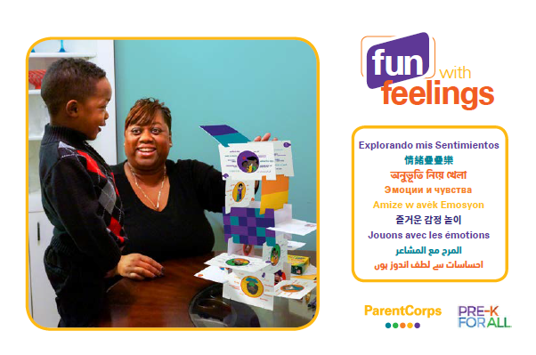
স্বাগতম পরিবারবর্গ!
আমরা আপনাকে নিচের বিষয়ের কোনও একটি নিয়ে আপনার আশেপাশের লোকদের সঙ্গে কথা বলার পরামর্শ দিচ্ছি:
এমন কোনও মূল্যবোধ যা আপনার তরুণ বয়সে আপনার ভেতর বপন করা হয়েছে
আপনার কোনও লুকানো প্রতিভা
আপনার কম্যুনিটির কোনকিছু যা আপনি পছন্দ করেন
আপনার প্রি-কে পরিবারবর্গকে জানতে!
Notes:
Welcome/Ice-breaker (5-10 mins)
*Note: This Power Point is for an event with adults only. You can find more suuport in your Pre-K Teacher, Leader and Staff Handbook.
Greet families warmly and orient them to the ice-breaker activity.
Encourage participants to move around the room and introduce themselves. Ask them to get to know a little about one another by sharing a response to one (or more) of the prompts on the slide.
*Have a plan to welcome late-comers and transition them smoothly into the current activity.

Slide 2
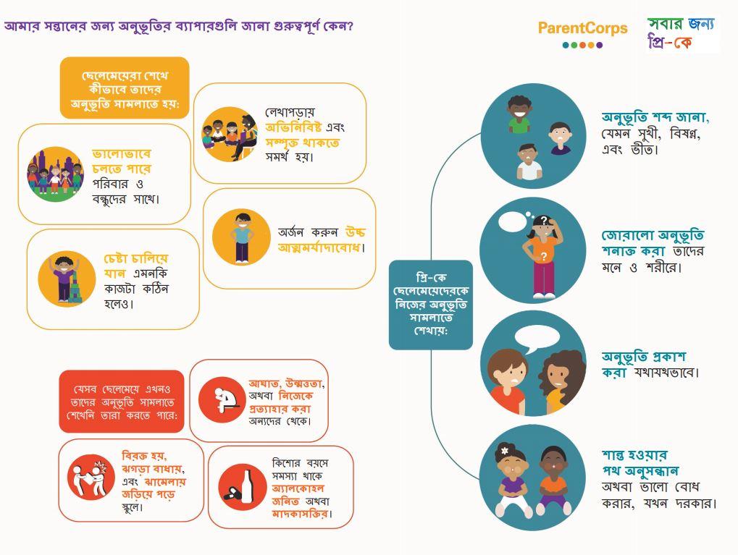
কেন ছেলেমেয়েদের জন্য
অনুভূতি সম্পর্কে জানা
গুরুত্বপূর্ণ?
Notes:
Why is it important? (5-10 mins)
Invite families to return to their seats and come back together as a whole group.
I am so excited to see you all here today! The fact that you have made time to come to your child’s school to learn more about how you can support their development speaks volumes about how dedicated you are to their growth and success.
So, we are here to learn about a special resource you will all receive to support your children’s social and emotional development, or more simply, to help them learn about and respond appropriately to feelings.
While academic material can often feel like the focus of school, in Pre-k we are still working on social and emotional skills...and for good reason!...
Young children at this age are just learning about feelings. It is common for them to yell and shout when they are happy, or to hit and throw things when they are angry.
There is very strong evidence that learning to deal with feelings matters, from studies that start when children are very young and follow their progress all the way through high school and adult life.
Walk through the infographic:
Children who learn to manage their feelings:
- Get along better with family and friends.
- Have higher self-esteem.
- Keep trying even when a task is difficult.
- Are better able to stay focused and engaged in learning.
Children who have not yet learned to manage their feelings are more likely to:
- Throw tantrums, hit, or withdraw from others.
- Get teased, get into fights, get in trouble at school.
- Have problems with alcohol or drugs as teenagers.
Pre-K helps children learn how to manage their feelings.
Learning to manage feelings means:
• Learning feeling words, such as happy, sad, and scared.
• Recognizing strong feelings in their minds and bodies.
• Expressing feelings appropriately.
• Finding ways to calm down or feel better, when necessary.
Ask: How does this all sound to you? Why do you believe learning these skills is important?
Affirm participants’ responses as they share with the group and thank them for sharing.
Social and Emotional Development is also one of the major domains in New York State’s Pre-k Foundations for the Common Core, in recognition that that learning about feelings is an essential part of building a foundation for children
to succeed as they move up to kindergarten and beyond.
*HANDOUT AVAILABLE: Note that this slide can be found on pages 4 & 5 of your Teacher/Leader/Staff Handbook, and can be copied as a handout for families. It is also available to be printed online.

Slide 3
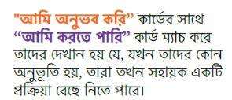

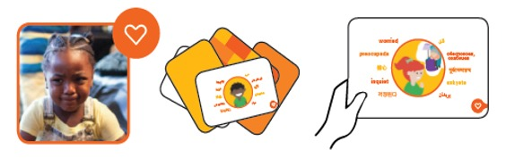
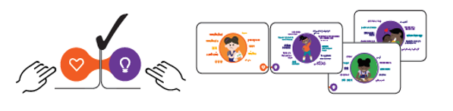
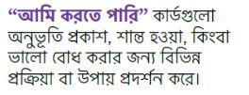
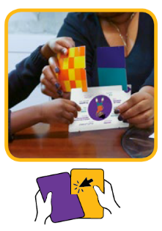
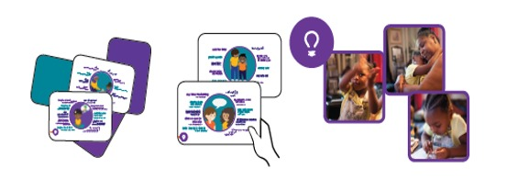
অনুভূতি কার্ড নিয়ে মজা!
প্লাসs: আপনি কাটাগুলিকে একত্রে ঠেলে কার্ড দিয়ে কিছু বানাতে পারেন।
Notes:
Introduce Handbook and Model (5 mins)
Show families the Fun with Feelings cards
Show and explain the two types of cards included in the deck:
orange “I feel” cards show different feelings”
purple “I can” cards show different actions you can take to express the feeling, calm down or feel better.”
At the bottom of these cards there are little icons: a heart on the feelings cards and a lightbulb on the action cards. The icons match up together when you connect a feeling to an action.
Demonstrate how the icons match up at the bottom when you put the cards together.
The cards can also be used to build with!
Demonstrate how the cards can be used to build by connecting the slits.

Slide 4

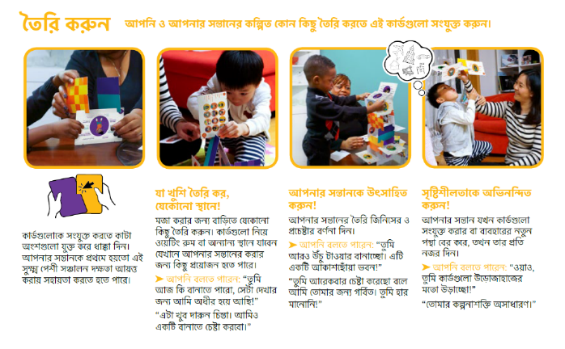
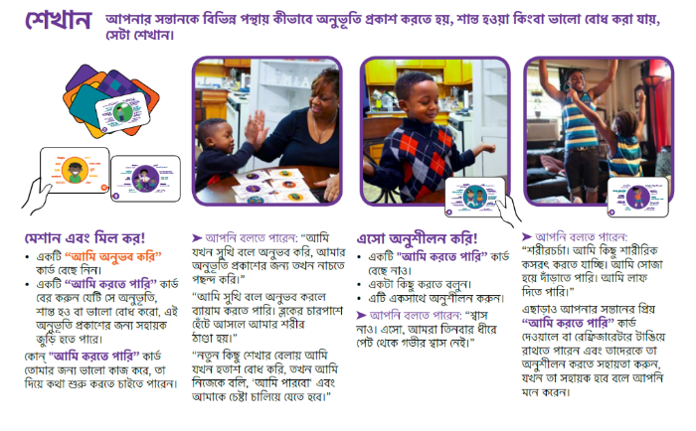
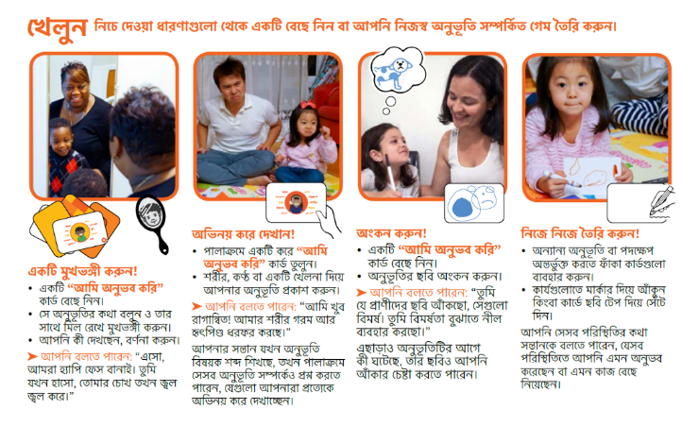
হ্যান্ডবুকে কী আছে দেখুন!
Notes:
Introduce Handbook, Model, & Activity (15-20 mins)
Show families the Family Handbook they will receive with their deck.
Show the three sets of instruction pages.
“The Build, Play, Teach cards offer ideas for fun activities to get you started with the cards, but you can make them your own too! As we explore the cards today, I encourage you to think about how these cards would work best for your family.”
Model how you might use one of the Play ideas from the Family Handbook with a child.
For example, read “Make a Face” on the Play page in the handbook (p. 4), hold up an “I feel” card, say the feeling and make the face that goes with it.
Activity:
1. Ask families to split into three groups.
2. Give each group one section of the Hand-book to focus on: Build, Play, or Teach.
3. Ask each group to pick 1 or 2 ideas from their section and practice using the cards together.
Ask for a volunteer in each group to read the instructions aloud before they practice using the cards together.
Once families are familiar with the cards, encourage them to role play with one person playing the role of a child and the rest of the group as adults. Families could also role play in smaller groups or pairs.
It can be helpful for parents to pretend to be their own child so they can anticipate how their child may engage with the cards.
Circulate to answer questions and check understanding. Acknowledge participation!
Invite families to share about their experience, favorite part, and/or any ideas they had about other ways to use the cards at home or on the go.
Ask:
How was that experience for you?
Did it spark any ideas about how you may want to use the cards?

Slide 5
আত্মজ্ঞিাসা ও লক্ষ্য নির্ধারণ
আপনার সন্তান এখুনি কী ধরনের সামাজিক-আবেগগত শক্তি প্রদর্শন করে?
আপনি কী কী আচরণ কম দেখতে আগ্রহী?
এর বদলে আপনি কী ধরনের আচরণ দেখতে আগ্রহী?
সন্তানের জন্য
আপনার লক্ষ্য ☺
ছেলেমেয়েরা যেসব সামাজিক-আবেগগদ দক্ষতা
উপর কাজ করতে পারে তার দৃষ্টান্ত:
  নানা ধরনের অনুভববেদ্য শব্দ জানা
  লক্ষ রাখুন যখন তার সমস্যাজনক কোনও অনুভূতি অভিজ্ঞতা করে
  তাদের অনুভূতি যথাযথভাবে প্রকাশ করে
  তাদেরকে শান্ত করার অথবা যখন প্রয়োজন তখন ভালোবোধ করার যথাযথ উপায় বেছে নিন
Notes:
Self-Reflection & Goals (5-10 mins)
Invite families to think about or write down a social-emotional skill their child is already successful in and then one goal they have for their child this year. Families may not want to share with the group, but you can invite them to talk with their child’s teacher about this goal:
“We talked today about emotions and why it is so important for your children to learn about them. Given what we have learned, what social-emotional strengths does your child show already? Maybe sharing or naming their feelings?”
Provide other examples, as needed.
Give families a minute to think or talk quietly at the table.
“Now, think about what behaviors you see now and the behaviors you want to see instead. What is a goal you have for your child this year? For example, my daughter gets so frustrated when she’s drawing. She rips her paper. I want her to keep trying and feel proud of what she can do. That is my goal.”
Ask if anyone would like to share one of their goals and/or ideas for using the cards at home with their children. You might refer back to ideas shared after the activity, add ideas, pull from the instruction cards and/or brainstorm together new ways to use the cards for particular goals.
After some participants have shared out, encourage everyone to connect with their child’s teacher about Social Emotional Learning:
“If you are interested, consider sharing your goals, reflections, or any questions with your child’s teachers to learn more about your child’s Social Emotional Learning.”

Slide 6
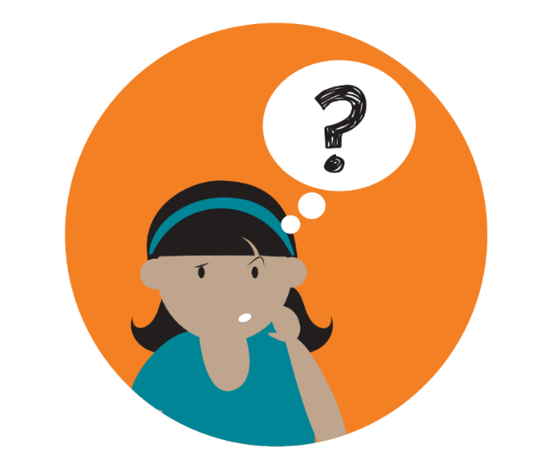
প্রশ্ন?
Notes:
Do you have any lingering questions right now?

Slide 7

ভাবনা
আজ নতুন কোন বিষয়টি আপনি জানতে পেরেছেন?
Notes:
General Reflection (5 mins)
Before we go, What is one thought you are leaving with today?
Affirm and thank families for sharing.

Slide 8

আপনাকে ধন্যবাদ!
Notes:
• Thank families for attendance and participation.
• If possible, make yourself available for brief one-on-one interactions with families as they leave.

