Slide 1
Food Education in Your School
September 1, 2023

Slide 2
The objective of the Food Education Roadmap is to operationalize the administration’s priority of health and wellbeing through food, starting with our kids.

Slide 4
Achieving our vision will require partnership and innovation, a whole of government approach, and a commitment to equity and data
Equity
Hands-On Learning
Knowledge & Habits
Food Literacy
All New York City students and families develop a culture of healthy eating, wellness, and lifelong habits through access to healthy food, nutrition education, experiential learning, and community involvement
Access to Plant-Based Meals
Consumption
Quality Food Experience
Adherence to Food Standards
Community
Food & Wellness in Community
Data

Slide 5
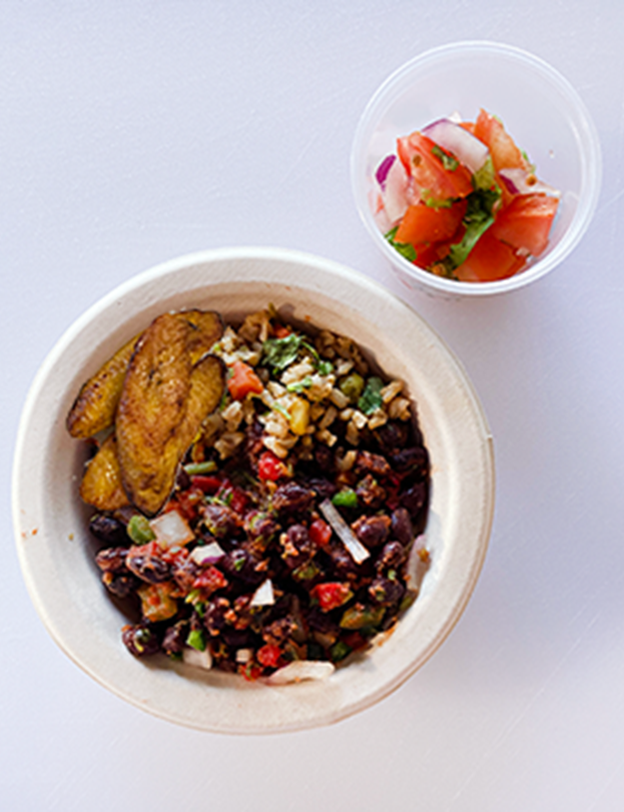
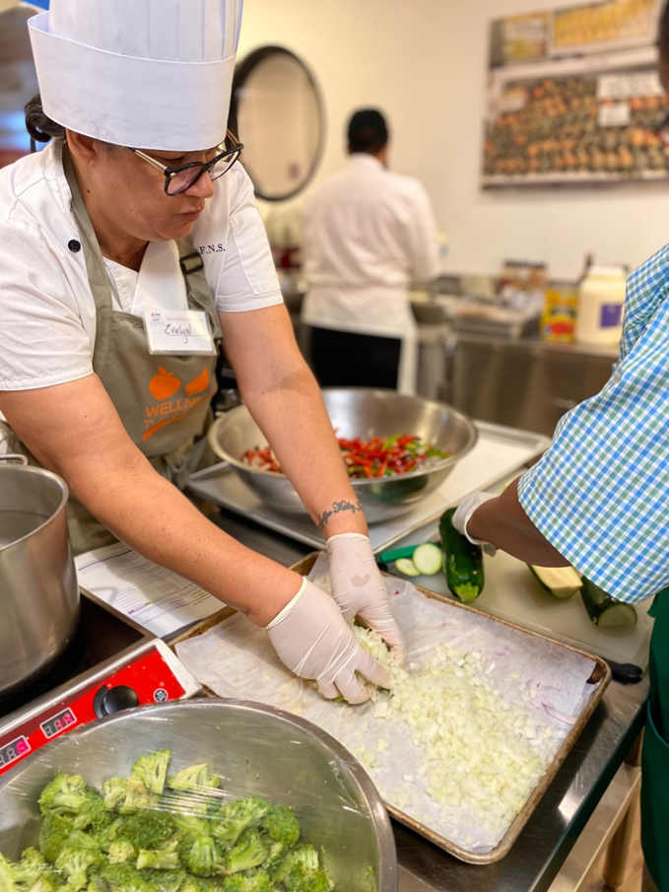
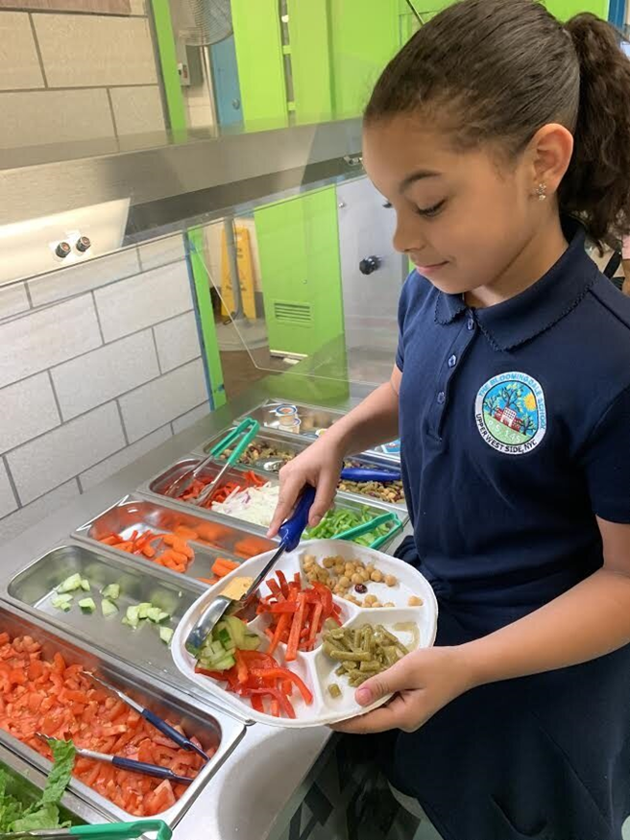
Chris Tricarico, Senior Executive Director, Office of Food and Nutrition Services

Slide 6
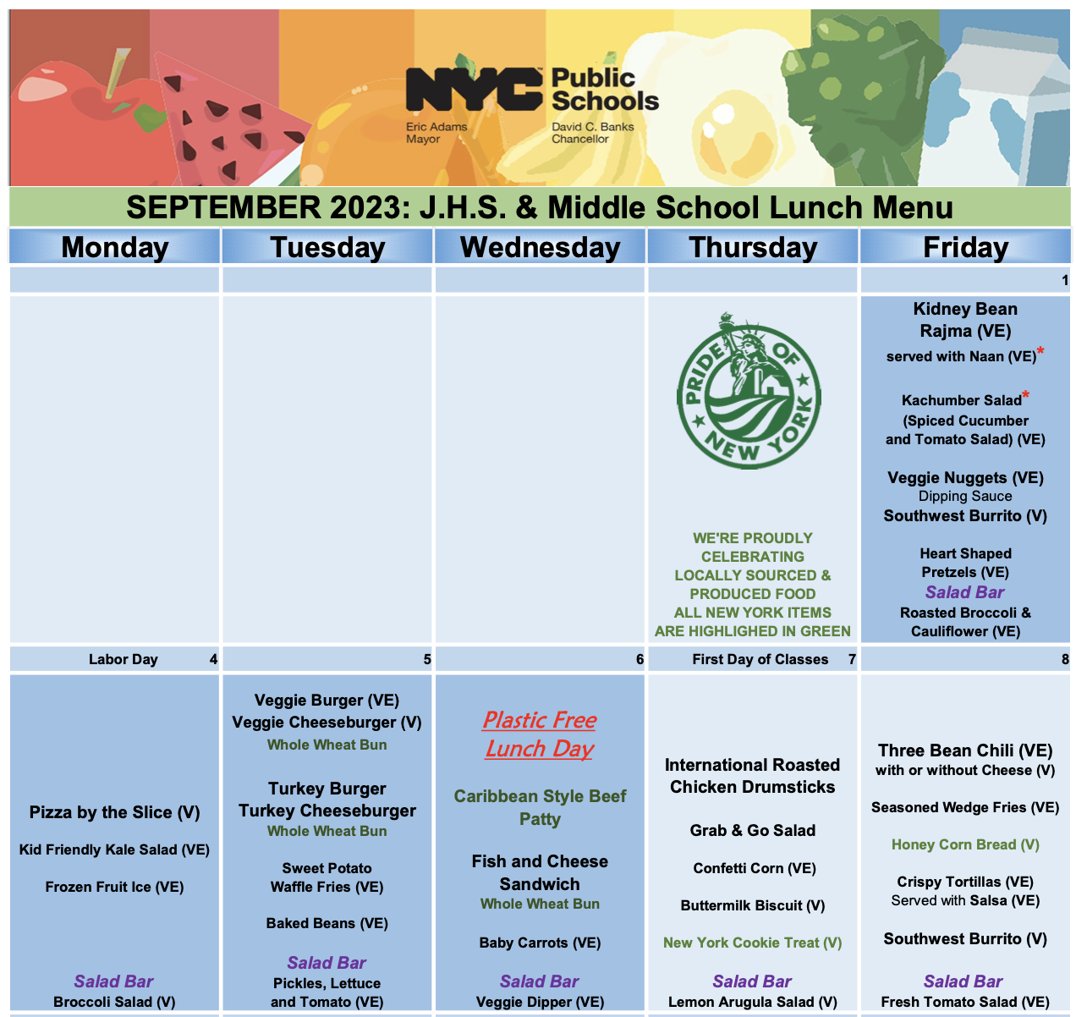

Slide 9
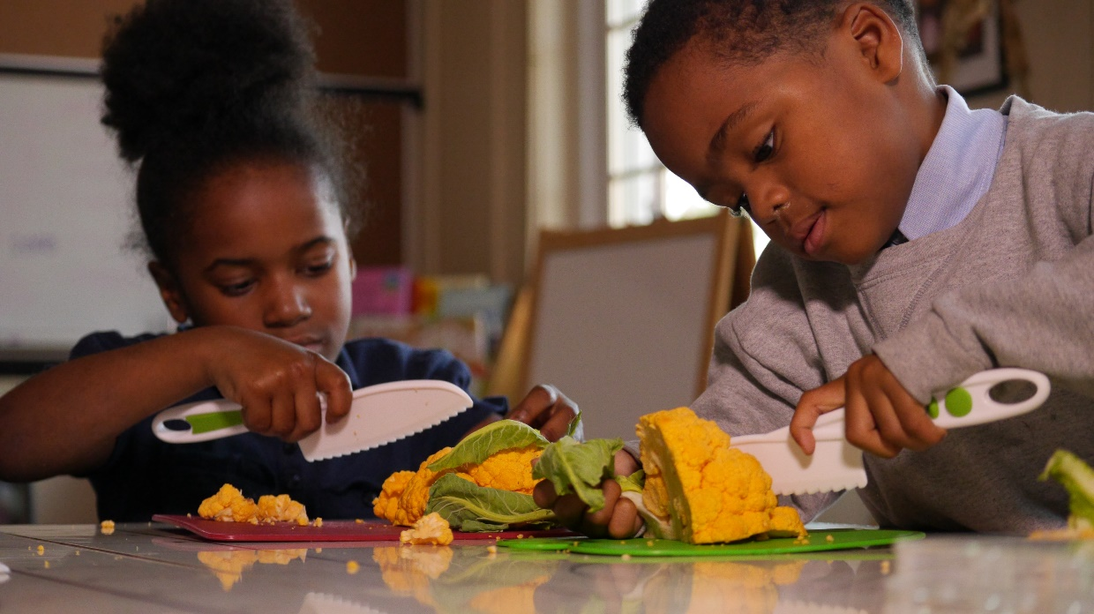
Jeremy Walter Food Education, Division of Curriculum and Instruction

Slide 10
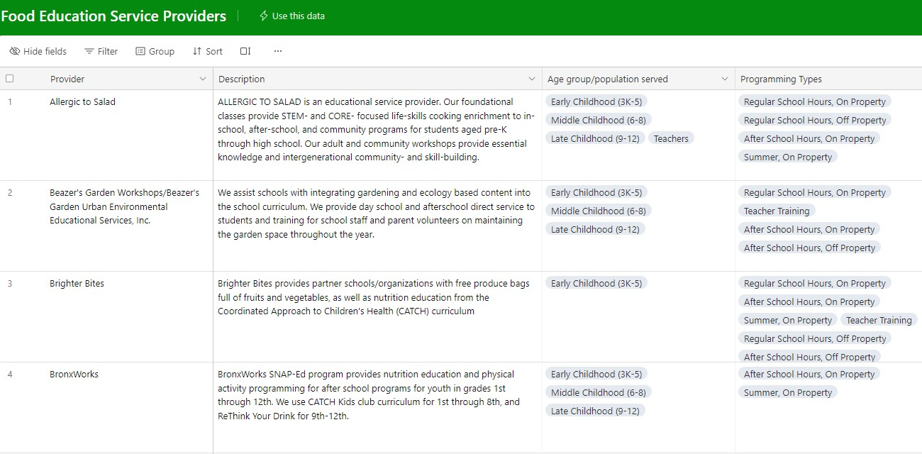
Food Education Service Providers

Slide 11
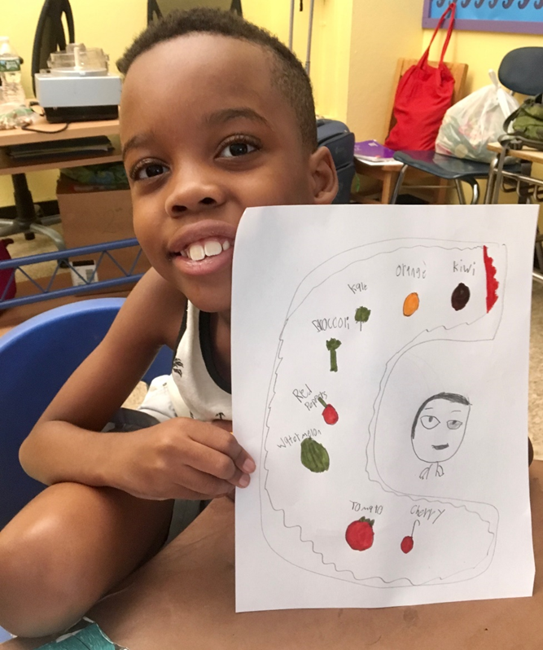
Interactive Food Education Service Provider tool (link in chat)
Professional learning opportunities for ALL teachers that are interested
School Leader Guide to Food Education
Food Education Grant Program

Slide 12
IMPORTANT LINKS & CONTACT INFORMATION
Search for experienced Food Education service providers using the Food Education Service Provider List
Share your suggestions and promising practices HERE!
Food and Nutrition Education: Jeremy Walter
Email: jwalter2@schools.nyc.gov
Phone: (212) 374-3467
Food Service: Chris Tricarico
Email: ctricar@schools.nyc.gov
Phone: (917) 941-7082

